Slide 1
Verification Techniques The Elevator System
Gordon J. Pace and Christian Colombo
University of Malta
October 2020

Slide 2
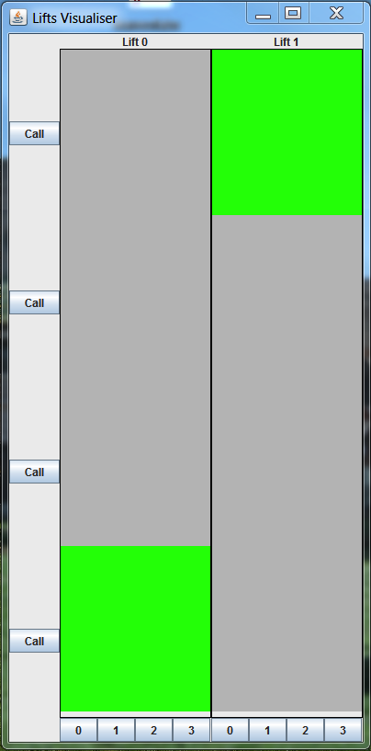
Elevator initial state

Slide 3
Summon elevator

Slide 4
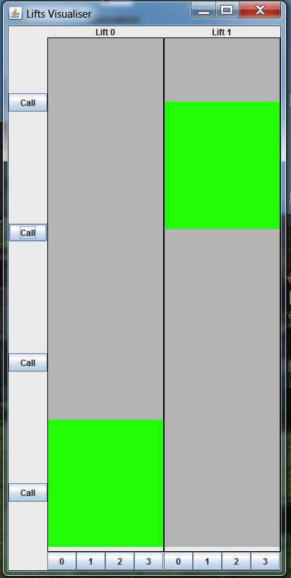
Lift 1 starts moving

Slide 5
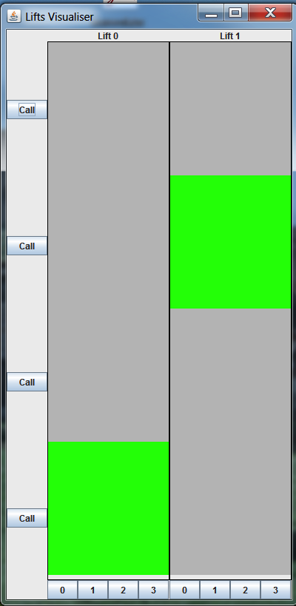
Lift 1 arrives and stops

Slide 6
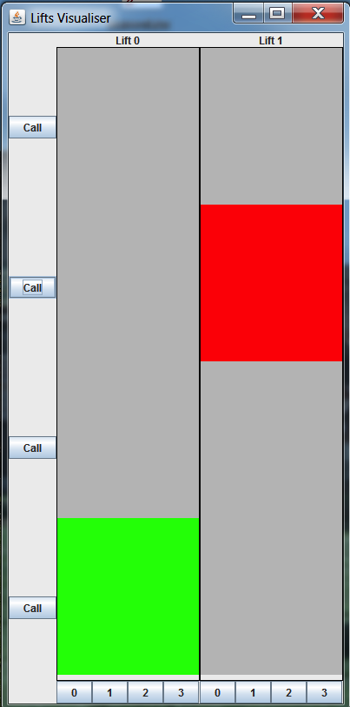
Lift 1 opens door

Slide 7
User requests floor 0

Slide 8
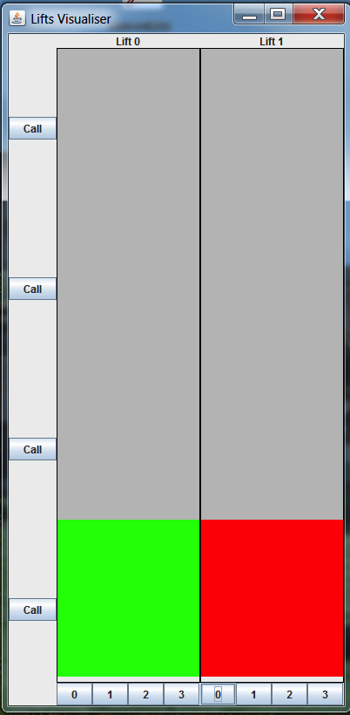
Elevator moves to floor 0, stops and opens door

Slide 9
Exercise
Can you mention some properties?

Slide 10
Understanding the System
The elevator system has the following buttons:
elevator summoning (1 at each floor)
elevator floor request (1 per floor in each elevator)

Slide 11
Understanding the System
The elevator system has the following sensors:
door is open/close
elevator is stationary/moving
elevator is at a particular floor
elevator is in between floors

Slide 12
Understanding the System
The elevator system has the following control signals:
open/close door
go up/down
stop

Slide 13
Invariants
elevator never moves up/down when the door is not closed
elevator never attempts to go above the topmost floor/below the lowermost floor
elevator never moves unless a button press occurs which has not yet been serviced
elevator never stops in between floors
elevator doors are only opened once the elevator reaches a floor

Slide 14
Temporal Properties (1)
when a button (summon or floor request) is pressed, the elevator eventually services the request (Model checking only)
multiple presses of the same button in between servicing are considered as a single request
if an elevator is moving through a floor for which a summons button has been pressed, the elevator should service that floor. Otherwise, the elevator closest to the requested floor should service it.

Slide 15
Temporal Properties (2)
door opening/closing signals always alternate each other; there should never be two consecutive door opening/two consecutive door closing.
if the summon button is pressed for a floor where the door is closing, the door should open again
if the summon button is held down on a floor where the door is not closed, then the door should open and remain open (while the button is held down)

Slide 16
Real-Time Properties
upon a request, after the door closes, the elevator starts moving in less than 3 seconds
after the door has been open for 3 seconds, it closes automatically

